Slide 1
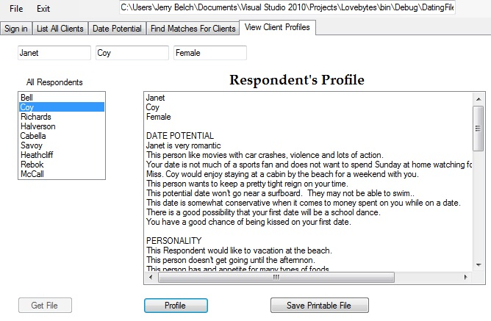
Notes:
Here is the results of the profile page of our program. It is a profile of Janet Coy. The profile is determined by a series of algorithms that are tied to each response in the questionnaire.

